Slide 1
Java Data Access (I/O Framework)
Università di Modena e Reggio Emilia
Prof. Nicola Bicocchi (nicola.bicocchi@unimore.it)

Slide 2
java.io.File
An abstract representation of file and directory pathnames. Provides access to a number of file attributes (length, rights, etc.) and a mapping between File and String
Constructor
File f = new File(“/etc/passd”)
Methods:
exists(), isFile(), isDirectory(), isHidden(), length(), canRead(), canWrite(), canExecute(), getPath()…

Slide 3
java.io.File
Platform dependent
File f = new File("tmp/abc.txt");
Platform independent
File f = new File(“tmp” + File.separator + "abc.txt");
@See Java System Properties
@See File class static attributes

Slide 4
Abstractions
Stream-oriented abstraction
I/O operations work in the same way with all kinds of streams. For example, a stream can be: standard input, standard output, standard error, ordinary files, data from/to memory or a pipe, or a network connection
Random access abstraction
A random access file behaves like a large array of bytes stored in the file system. There is a kind of cursor, or index into the implied array, called the file pointer; input operations read bytes starting at the file pointer and advance the file pointer past the bytes read.
java.io.RandomAccessFile

Slide 5
Stream
Abstract classes: Reader Writer
For reading and writing streams of characters (Unicode characters are 16 bit)
Abstract classes: InputStream OutputStream
For reading and writing streams of bytes (8 bit)
Package java.io
Related exceptions are subclasses of java.io.IOException

Slide 6
java.io.Reader/InputStream
int read()
Read a single char
int read(char[] buffer)
Read chars into an array
long skip(long n)
Skip n chars
void close()
Close the stream
int read()
Reads a single byte (packed into an int)
int read(byte[] buffer)
Reads bytes into an array
long skip(long n)
Skips n bytes
void close()
Close the stream

Slide 7
java.io.Writer/OutputStream
void write(int c)
Write a single char
void write(char[] buffer)
Write an array of chars
void write(String str)
Write a string
void flush()
Flush the stream
void close()
Close the stream, flushing it first
void write(int b)
Write a single byte
void write(byte[] buffer)
Write an array of bytes
void flush()
Flush the stream
void close()
Close the stream, flushing it first

Slide 8
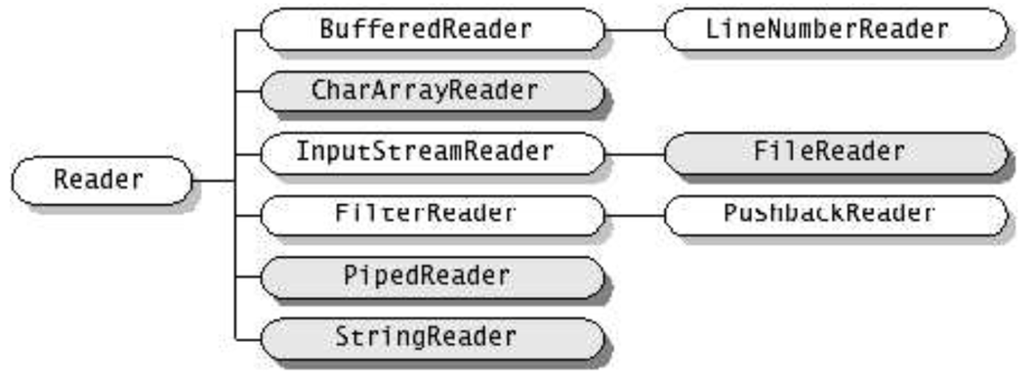
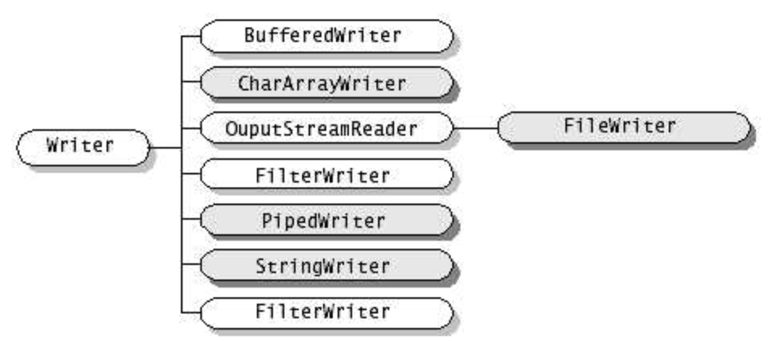
Reader and Writer

Slide 9
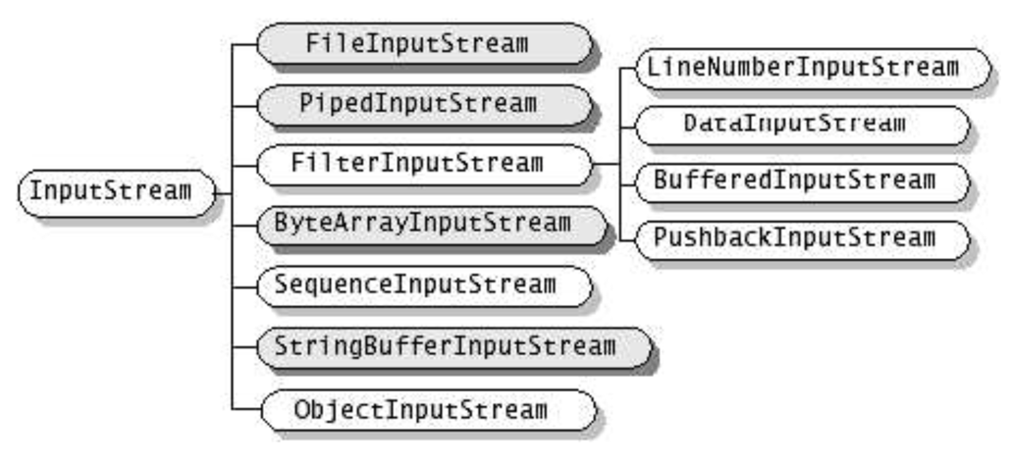
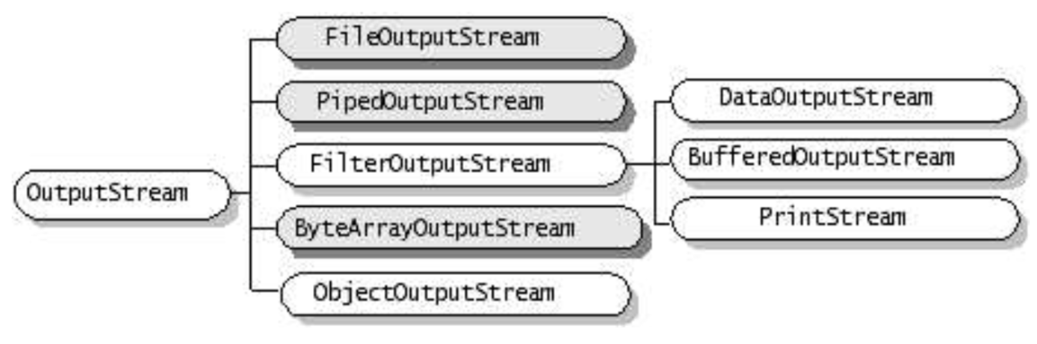
InputStream and OutputStream

Slide 10
Read/Write files
R/W characters from files
java.io.FileReader
java.io.FileWriter
R/W bytes from files
java.io.FileInputStream
java.io.FileOutputStream

Slide 11
Read/Write pipes
R/W chars from pipes
java.io.PipedReader
java.io.PipedWriter
R/W bytes from pipes
java.io.PipedInputStream
java.io.PipedOutputStream

Slide 12
Read/Write in memory
R/W chars from/to arrays of chars
java.io.CharArrayReader
java.io.CharArrayWriter
R/W chars from/to Strings
java.io.StringReader
java.io.StringWriter
R/W bytes from/to arrays of bytes
java.io.ByteArrayInputStream
java.io.ByteArrayOutputStream

Slide 13
Print Streams
Specialization of OutputStream
A PrintStream adds functionality to a generic outputstream. Specifically the ability to print convenient representations of various data.
Adds methods like print(), println(), printf(), format() for string formatting
The System class defines standard input, output and error as streams:
class System {
static InputStream in;
static PrintStream out;
static PrintStream err;
…
}

Slide 14
Buffered Streams
Buffered streams add buffering functionality to ordinary streams.
An explicit alternative to buffered streams is the use of read(int[] buf) or read(char[] buf).
BufferedInputStream(InputStream i)
BufferedOutputStream(OutputStream o)
BufferedReader(Reader r)
BufferedWriter(Writer w)

Slide 15
Interpreted Streams
Translate primitive types in standard format (UTF-8) on a stream
DataInputStream(InputStream i)
readByte(), readChar(), readDouble(), readFloat(), readInt(), readLong(), readShort()
DataOutputStream(OutputStream o)
writeByte(), writeChar(), writeDouble(), writeFloat(), writeInt(), writeLong(), writeShort()

Slide 16
Object Streams

Slide 17
java.nio.file.Path
https://www.baeldung.com/java-path-vs-file

Slide 18
java.nio.file.Files
https://jenkov.com/tutorials/java-nio/files.html

